Slide 1
Online Shop
Back-end

Slide 2
Stack
MSSQL (v. 18.2)
ASP.NET Core (v. 3.0)
Entity Framework Core (v. 3.0)
SeriLog (v. 2.9)
Identity Model (v. 4.1)
Swagger (Swashbuckle) (v. 5.0)

Slide 3
Project Structure
Back-end
API
Front-end implementation 1
Front-end implementation 3
Front-end implementation 2

Slide 4
Back-end Layers
DTO
(Data Transfer Objects)
DAL
(Data Access Layer)
BLL
(Business Logic Layer)
API
(Services and Controllers)

Slide 5
Repository Design Pattern
Repository Design Pattern acts as a middleman or middle layer between the rest of the application and the data access logic.
That means a repository pattern isolates all the data access code from the rest of the application.
The advantage of doing so is that, if you need to do any change then you need to do in one place.
Another advantage is that Repository systems are good for testing.

Slide 6
Dependency Injection Pattern
DI is a software design pattern that allows to develop loosely coupled code.
DI is a technique to create a dependency or dependencies outside the class that uses it.
In case of Constructor Injection, Dependency Injection is done by supplying the DEPENDENCY through the class’s constructor when creating the instance of that class.
Injected component can be used anywhere within the class.

Slide 7
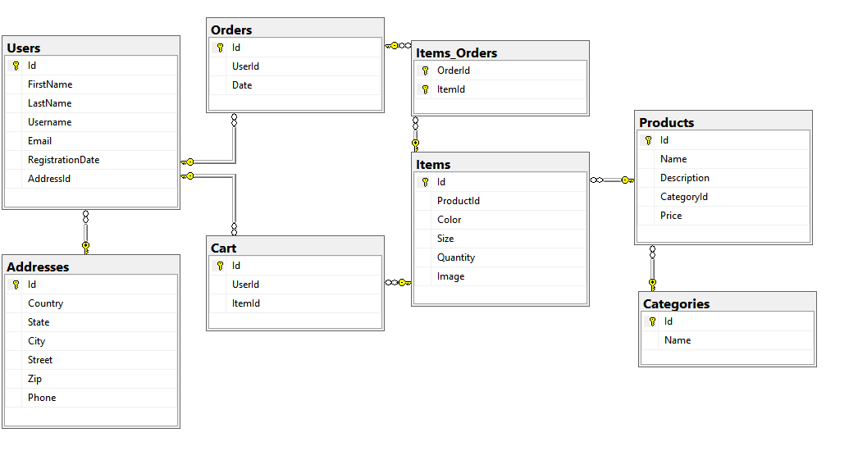
Database Structure

Slide 8
Data Access Layer
Access to DB data for DML:
create
read
CRUD implementation for:
Users
Addresses
update
delete
Categories
Products
Items
Orders
Cart

Slide 9
Business Logic Layer
DAL logic
Custom Logic
Business Logic Layer

Slide 10
API
API
Services
BLL
Controllers

Slide 11
Controllers
Custom Base Controller
Users Controller
Category Controller
Product Controller
Items Controller
Cart Controller

Slide 12
Users Controller
Supports user related actions:
User Register Action
registers a new user
User Login Action
logs in a registered user
Get, Add, Update, Remove Address Actions
gets an existing address, adds a new address, updates an existing address, removes an existing address
Update User By Address Action
assigns address to user

Slide 13
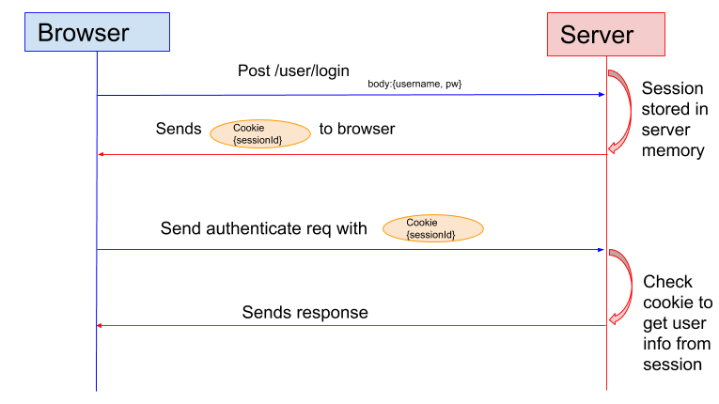
Authentication/Authorization

Slide 14
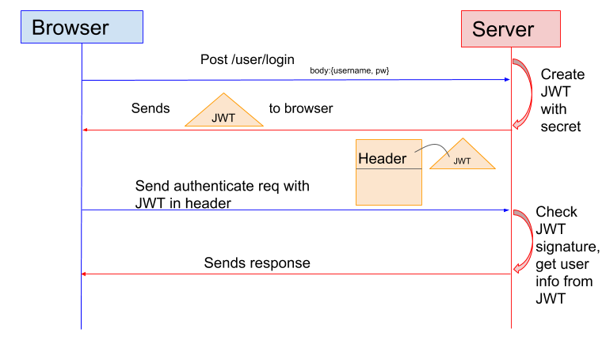
Authentication/Authorization: JWT

Slide 15
Category Controller
Supports category related actions:
Categories Action
gets all existing categories
Category Action
gets a specified category
Get, Add, Update, Remove Category Actions
gets an existing category, adds a new category, updates an existing category, removes an existing category

Slide 16
Products Controller
Supports product related actions:
Products Action
gets all existing products
Products In Category Action
gets all existing products from specified category
Get, Add, Update, Remove Product Actions
gets an existing product, adds a new product, updates an existing product, removes an existing product
Product Action
gets a specified product

Slide 17
Items Controller
Supports item related actions:
Items Action
gets all existing Items
Items Of Product Action
gets all existing products of specified Product
Get, Add, Update, Remove Items Actions
gets an existing item, adds a new item, updates an existing item, removes an existing item
Item Action
gets a specified item

Slide 18
Cart Controller
Supports cart related actions:
Cart Action
shows cart (items of the cart) to the user
Add To Cart Action
adds a specified item to the cart
Remove Action
removes a specified item from the cart

Slide 19
Cart Controller
Also supports orders related actions:
Order History Action
shows all the orders of the user
Place Order Action
places a new order from an existing user cart
Cancel Order Action
removes a placed order within 1 hour after being ordered

Slide 20
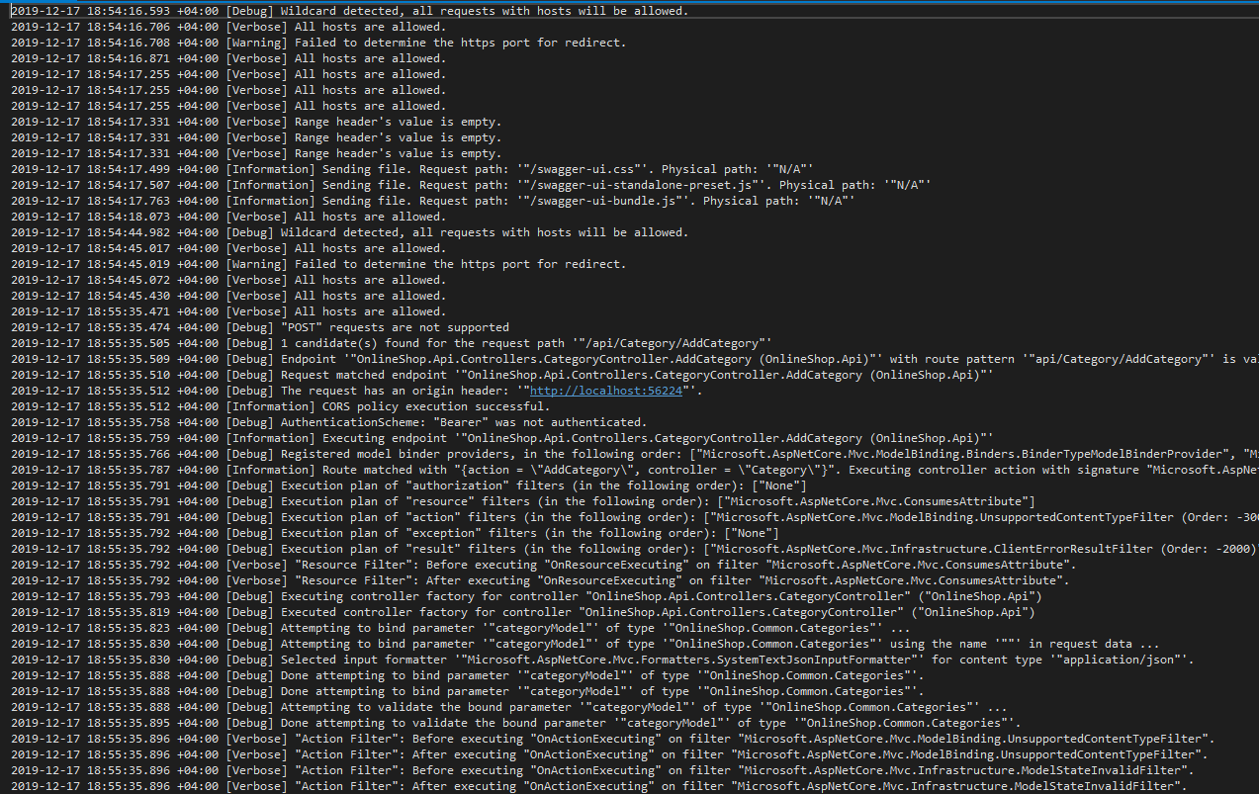
Logging: Serilog

Slide 21
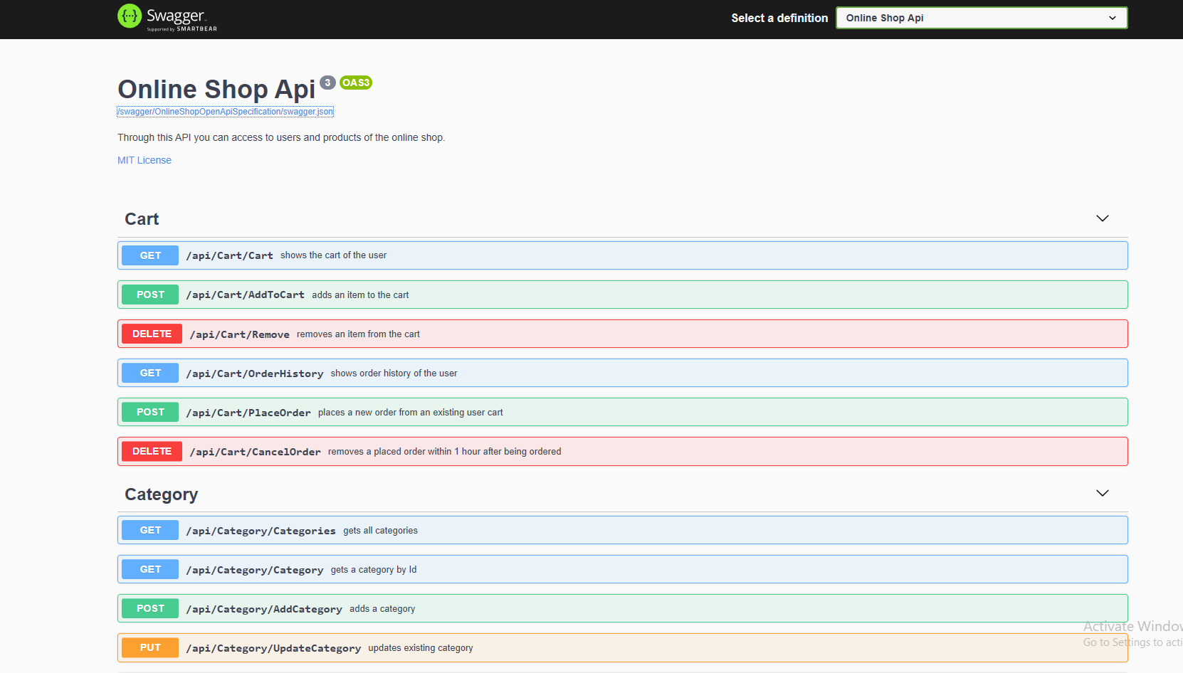
Documentation: OpenAPI / Swagger

Slide 22
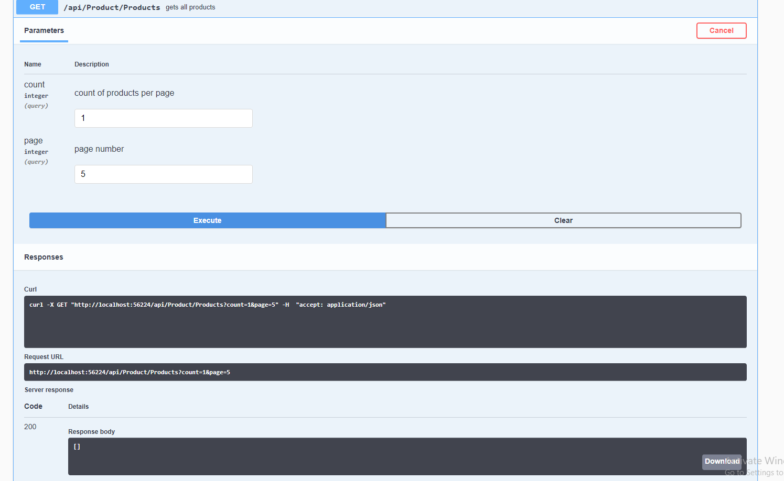
Testing: Swagger

Slide 23
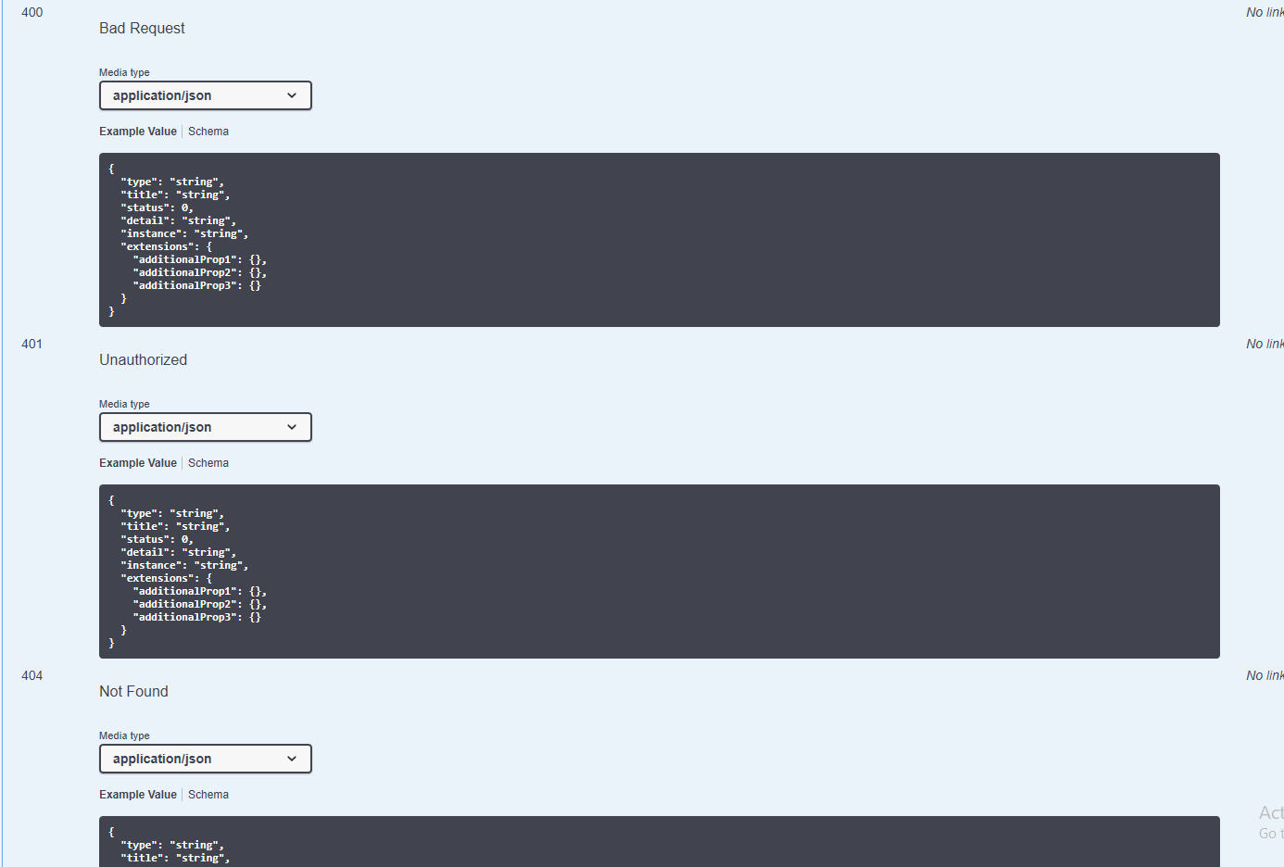
Testing: Swagger (not successful requests)

Slide 24
Q & A

Slide 25
Thank you!

